Slide 1
Person Re-ID
Luo Hao
2017/5/18

Slide 2
Content
Introduction
Papers
Experiments
Future works

Slide 3
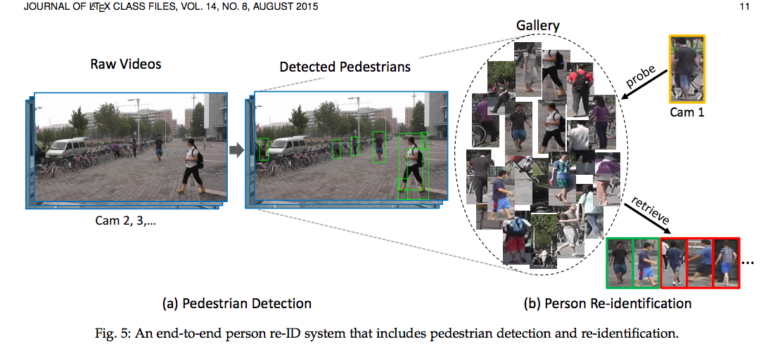
Introduction: from detection to re-identification

Slide 4
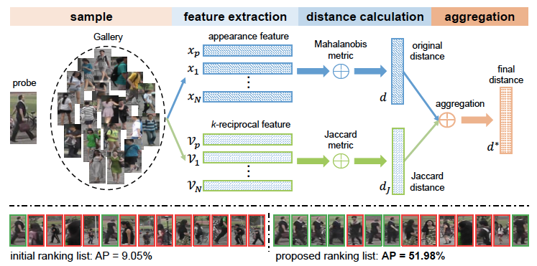
Introduction: metrics
Test by single query: 1 probe & N query, each person happens one time
Judge through L2 distance: how to find a better feature representation

Slide 5
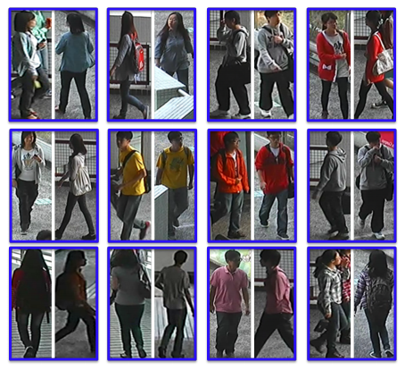
Dataset
CUHK03
1360 persons，
13164 bounding boxes
Market1501
1501 persons，
32643 bounding boxes
CUHK-SYSU
8432 persons,
99,809 bounding boxes
MARS
1261 trajectories

Slide 6
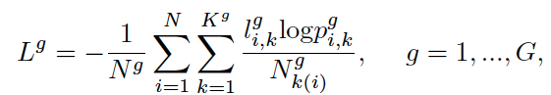
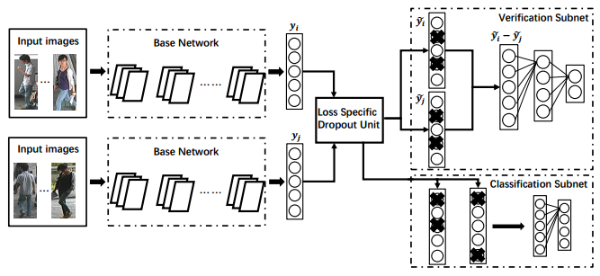
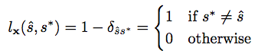
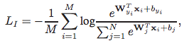
Loss
Attributes loss
Verification loss
Identification loss
Distance loss
Pair loss
Triplet loss
Improve triplet loss
Quadruplet loss
My quintuplet loss

Slide 7
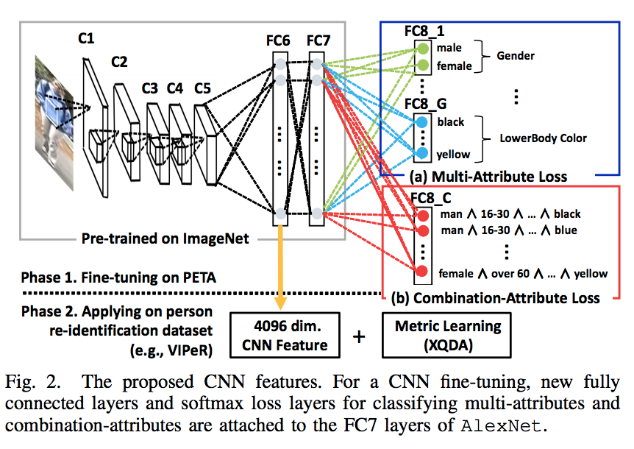
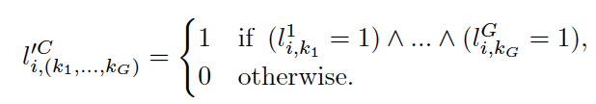
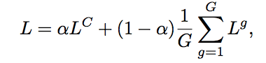
Person Re-Identification Using CNN Features Learned from Combination of Attributes (ICLR2016)
Full label
Attributes label loss
Loss
Top1
VIPeR:46.3%
CUHK01:49.9%
PRID450S:56.5%
GRID:24.3%

Slide 8
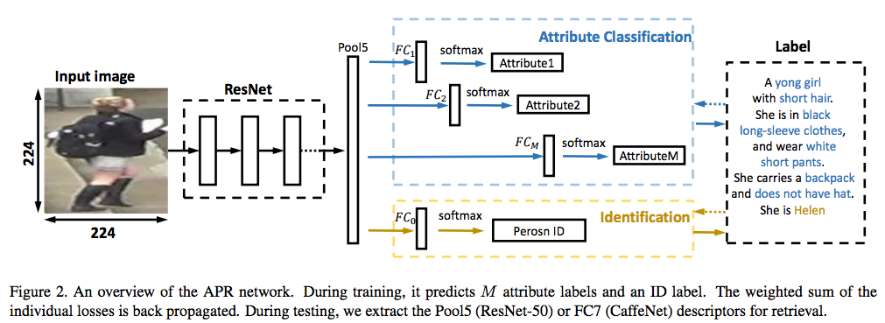
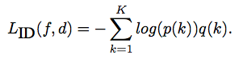
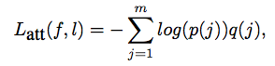
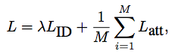
Improving Person Re-identification by Attribute and Identity Learning (L Zheng)
ID Loss
Attributes Loss
Final Loss
Top1:
Market1501: 84.29%
DukeMTMC-reID: 70.69

Slide 9
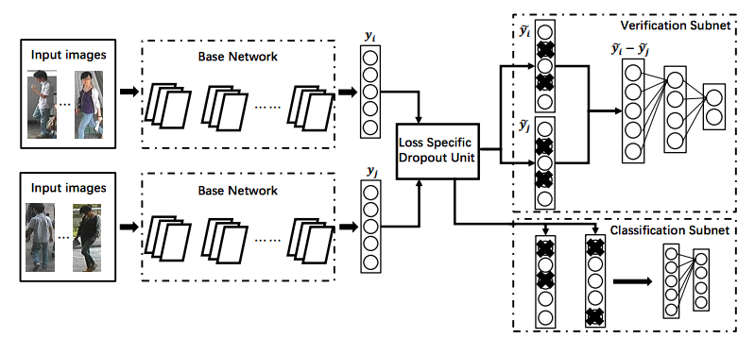
Deep Transfer Learning for Person Re-identification(Arxiv 2016)
Multi datasets
Unsupervised Transfer Learning
Fine-tune, many times
Top1: (maybe overfitting)
Market1501: 83.7%
Cuhk03: 85.4%

Slide 10
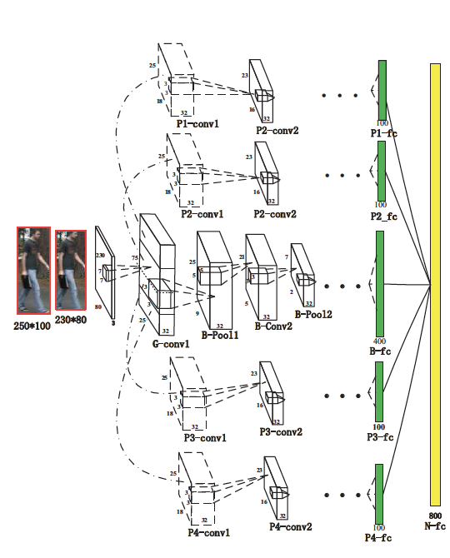
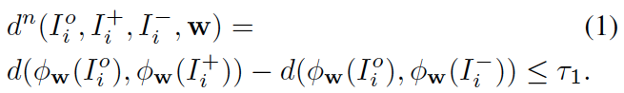
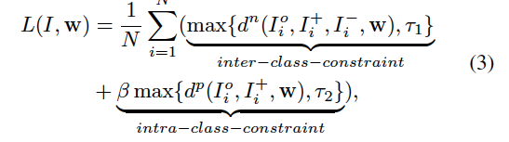
Person Re-Identification by Multi-Channel Parts-Based CNN with Improved Triplet Loss Function (CVPR2016）
Inter-class-constraint
Intra-class-constraint
Improved triplet loss function
Top1
VIPeR:47.8%
i-LIDS:60.4%
PRID2011:22.0%
CUHK:53.7%

Slide 11
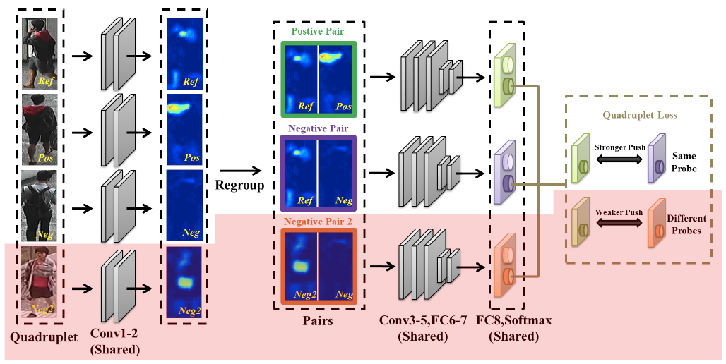
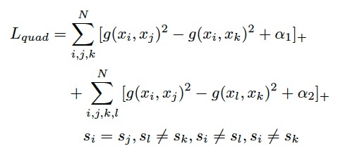
Beyond triplet loss: a deep quadruplet network for person re-identification (CVPR2017)
Quadruplet loss
i: Ref j: Pos
k: Neg1 l: Neg2
Top1
VIPeR:49.05%
CUHK01:62.55%
CUHK03:74.47%
With negative mining
Quintuplet: Ref1 Pos1 Neg Pos2 Ref2
Pos2 is Neg2 for Ref1; Pos1 is Neg2 for Ref2

Slide 12
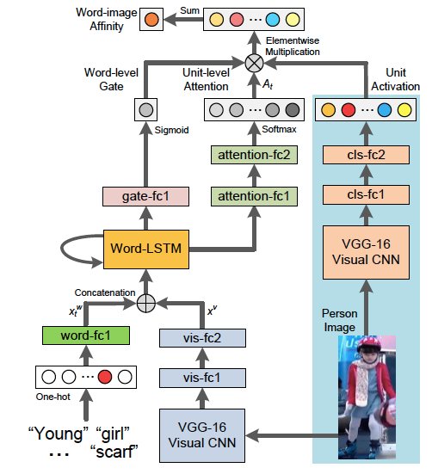
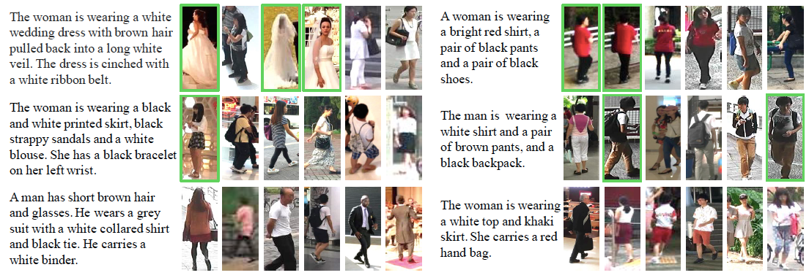
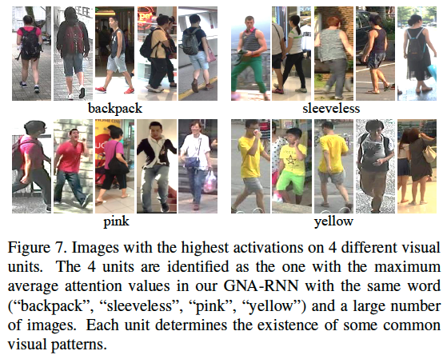
Person Search with Natural Language Description (Sensetime)

Slide 13
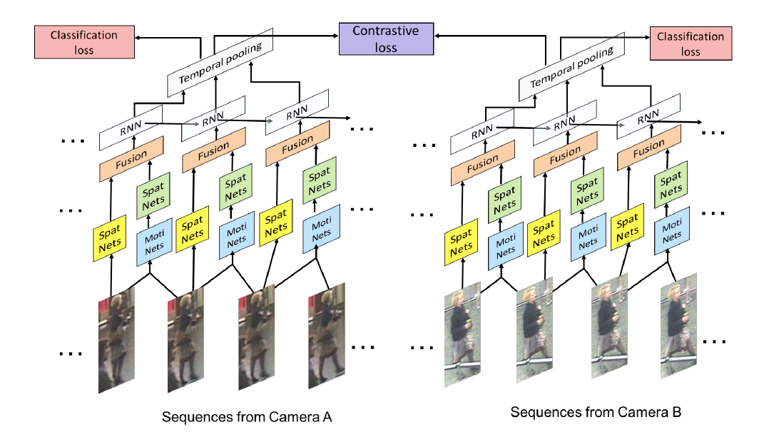
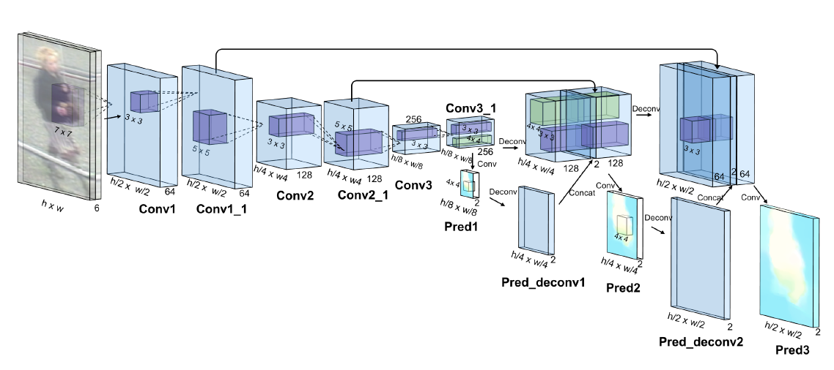
Video-based Person Re-identification with Accumulative Motion Context (颜水成)
Moti Nets: Flownet
Spat Nets: 3 layers CNN
Fusion: Concatenation fusion
Loss: Contrastive&Classification loss
Data: Crop&Mirror
Top1
PRID2011:83.7%
iLIDS-VID:68.7%

Slide 14
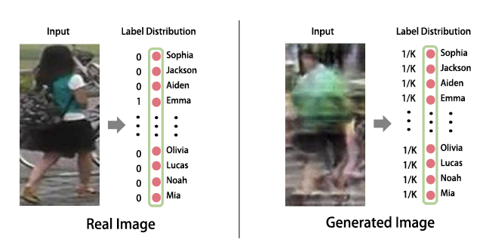
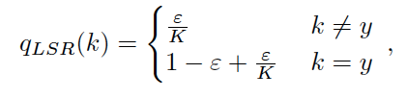
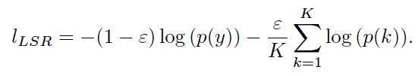
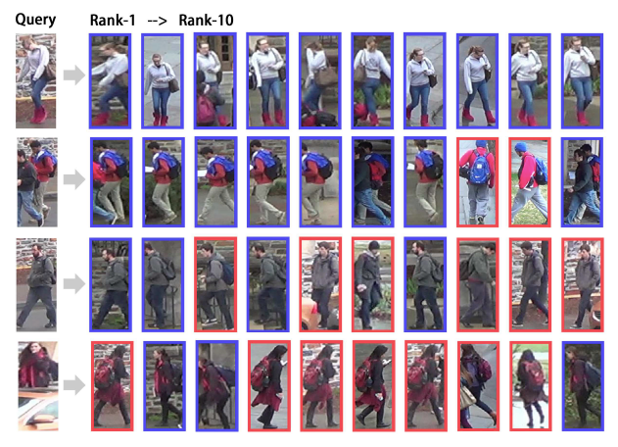
Unlabeled Samples Generated by GAN Improve the Person Re-identification Baseline in vitro
LSRO
Top1(self-network)
Market1501:78.06%
CUHK:73.1%
Top1(public network)
Market1501:83.97%
CUHK:84.6%

Slide 15
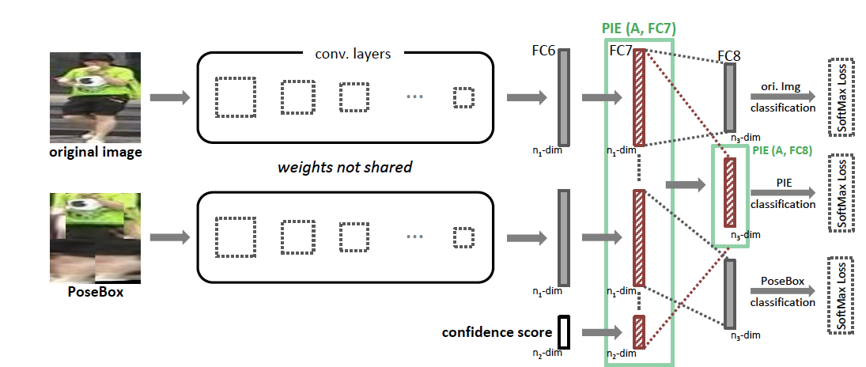
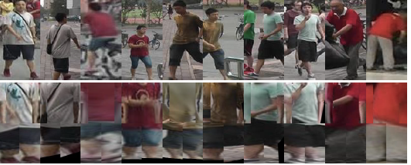
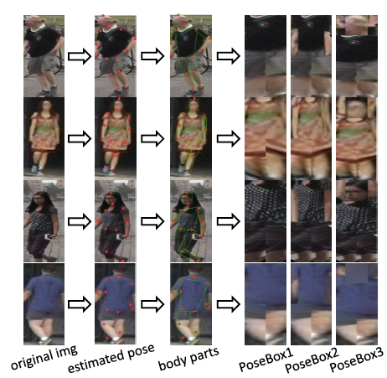
Pose Invariant Embedding for Deep Person Re-identification
Top1
Market1501:79.33%
CUHK:67.1%
VIPeR:54.49%
Pose: CPM network
Landmark: 14 points
Affine transformation: preprocessing

Slide 16
Experiments: model architecture
Resnet50
Pre-trained from ImageNet
Global AP
Fc1 1024
Multi inputs share the network
Feature 512
Normalize
Fc2 softmax
Distance loss
Classification loss

Slide 17
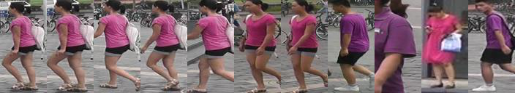
Experiments: results
train dataset | base model resnet50 | test dataset | train mode | Single query |  |  | mAP | time
 |  |  |  | top1 | top5 | top10
cuhk03 | freezing | cuhk03 | Resnet50 | 6.6 | 16.9 | 25.9 | /
 |  |  | class | 32.0 | 60.2 | 71.6 | /
 |  |  | triplet | 38.6 | 58.4 | 65.0 | /
 |  |  | class+triplet(100 ephcos) + feature normalize | 42.8 | 68.3 | 78.8 | /
 |  |  |  | 43.5(+1.5) | 69.3(+1.0) | 79.5(+0.7) | /
 |  |  | class+triplet(4000 ephcos) + feature normalize | 37.5 | 62.6 | 72.1
 |  |  |  | 38.8(+1.3) | 64.6(+2.0) | 75.7(+3.6) | /
 |  |  | class+imporve_triplet | 29.6(-3.5) | 59.0(-2.3) | 71.0(-1.9) | /
cuhk03 | fine-tuning | cuhk03 | Resnet+class(30 epochs) | 37.5 | 61.5 | 73.4 | /
 |  | market1501 |  | 25.7 | 50.4 | 63.0 | 27.4
 |  | cuhk03 | Resnet+class+feature normalize | 38.8(+1.3) | 66.5(+0.9) | 76.2(+2.8) | /
 |  | market1501 |  | 25.9(+0.2) | 51.0(+0.6) | 64.1(+1.1) | 27.8(+0.4)
 |  | cuhk03 | Resnet+triplet+feature normalize | 53.1 | 83.6 | 91.4 |  | 100
 |  | market1501 |  | 26.1 | 56.5 | 69.6 | 31.9
 |  | cuhk03 | Resnet+class+triplet+feature normalize | 56.3(+17.5) | 86.0(+19.5) | 92.8(+16.6) | / | 80
 |  | market1501 |  | 29.1(+3.2) | 60.4(+9.4) | 74.3(+10.2) | 36.0(+4.2)
 |  | cuhk03 | Resnet+class+quadtuplet+feature normalize | 56.0(+17.2) | 85.9(+19.4) | 92(+15.8) |  | 75
 |  | market1501 |  | 28.0(+2.3) | 58.1(+7.1) | 71.5(+7.4) | 34.9(+7.1)
 |  | cuhk03 | Resnet+class+quintuplet+feature normalize | 59.9(+21.1) | 86.7(+20.2) | 93.2(+17.0) |  | 60
 |  | market1501 |  | 25.2(-0.7) | 54.0(+3.0) | 67.8(+3.7) | 31.7(+3.9)
 |  | cuhk03 | Resnet+class&triplet+feature normalize | 63.1(+24.3) | 89.4(+38.4) | 94.3(+30.2) |  | 10/40
 |  | market1501 |  | 35.9(+10.0) | 62.5(+11.5) | 75.0(+10.9) | 37.6(+9.8)
cuhk03+ market1501 | fine-tuning +triplet transfer | cuhk03 | class+triplet+normalize | 43.1 | 69.3 | 78.9 | /
 |  | market1501 | class+triplet+normalize | 21.8 | 49.4 | 62.2 | 27.4
 |  | market1501 | unsupervised transfer | 7.5(-14.3) | 19.9(-29.5) | 27(-35.2) | 9.2(-18.2)

Slide 18
Experiments: freezing base model or not
train dataset | base model resnet50 | test dataset | train mode | Single query |  |  | mAP | time
 |  |  |  | top1 | top5 | top10
cuhk03 | freezing | cuhk03 | Resnet50 | 6.6 | 16.9 | 25.9 | /
 |  |  | class | 32.0 | 60.2 | 71.6 | /
 |  |  | triplet | 38.6 | 58.4 | 65.0 | /
cuhk03 | fine-tuning | cuhk03 | Resnet+class(30 epochs) | 37.5 | 61.5 | 73.4 | /
 |  | market1501 |  | 25.7 | 50.4 | 63.0 | 27.4
 |  | cuhk03 | Resnet+class+feature normalize | 38.8(+1.3) | 66.5(+0.9) | 76.2(+2.8) | /
 |  | market1501 |  | 25.9(+0.2) | 51.0(+0.6) | 64.1(+1.1) | 27.8(+0.4)
 |  | cuhk03 | Resnet+triplet+feature normalize | 50.1 | 81.6 | 89.4 |  | 100
 |  | market1501 |  | 26.1 | 56.5 | 69.6 | 31.9
fine tuning > freezing

Slide 19
Experiments: feature normalize or not
L2 normalize
train dataset | base model resnet50 | test dataset | train mode | Single query |  |  | mAP | time
 |  |  |  | top1 | top5 | top10
cuhk03 | freezing | cuhk03 | class+triplet(100 ephcos) + feature normalize | 42.8 | 68.3 | 78.8 | /
 |  |  |  | 43.5(+1.5) | 69.3(+1.0) | 79.5(+0.7) | /
 |  |  | class+triplet(4000 ephcos) + feature normalize | 37.5 | 62.6 | 72.1
 |  |  |  | 38.8(+1.3) | 64.6(+2.0) | 75.7(+3.6) | /
cuhk03 | fine-tuning | cuhk03 | Resnet+class(30 epochs) | 37.5 | 61.5 | 73.4 | /
 |  | market1501 |  | 25.7 | 50.4 | 63.0 | 27.4
 |  | cuhk03 | Resnet+class+feature normalize | 38.8(+1.3) | 66.5(+0.9) | 76.2(+2.8) | /
 |  | market1501 |  | 25.9(+0.2) | 51.0(+0.6) | 64.1(+1.1) | 27.8(+0.4)
Feature normalize improves performance

Slide 20
Experiments: classification or triplet
train dataset | base model resnet50 | test dataset | train mode | Single query |  |  | mAP | time
 |  |  |  | top1 | top5 | top10
cuhk03 | freezing | cuhk03 | Resnet50 | 6.6 | 16.9 | 25.9 | /
 |  |  | class | 32.0 | 60.2 | 71.6 | /
 |  |  | triplet | 38.6 | 58.4 | 65.0 | /
 |  |  | class+triplet(100 ephcos) + feature normalize | 42.8 | 68.3 | 78.8 | /
 |  |  |  | 43.5(+1.5) | 69.3(+1.0) | 79.5(+0.7) | /
 |  |  | class+triplet(4000 ephcos) + feature normalize | 37.5 | 62.6 | 72.1
 |  |  |  | 38.8(+1.3) | 64.6(+2.0) | 75.7(+3.6) | /
cuhk03 | fine-tuning | cuhk03 | Resnet+class+feature normalize | 38.8(+1.3) | 66.5(+0.9) | 76.2(+2.8) | /
 |  | market1501 |  | 25.9(+0.2) | 51.0(+0.6) | 64.1(+1.1) | 27.8(+0.4)
 |  | cuhk03 | Resnet+triplet+feature normalize | 53.1 | 83.6 | 91.4 |  | 100
 |  | market1501 |  | 26.1 | 56.5 | 69.6 | 31.9
 |  | cuhk03 | Resnet+class+triplet+feature normalize | 56.3(+17.5) | 86.0(+19.5) | 92.8(+16.6) | / | 80
 |  | market1501 |  | 29.1(+3.2) | 60.4(+9.4) | 74.3(+10.2) | 36.0(+4.2)
Performance: classification pre-train + triplet > triplet > classification
Time consuming: triplet >>> classification
Robustness: classification > triplet

Slide 21


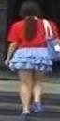

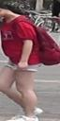
Experiments: different distance loss
Ref1
Pos1
Neg1
Pos2/Neg2
Ref2
Triplet loss
Dis(ref1 – pos1) – Dis(ref1 – neg1) + a1
Improve triplet loss
Triplet loss + Dis(ref1 – pos1)
Quadruplet loss
Triplet loss + Dis(ref1 – pos1) – Dis(neg1 – neg2) + a2
My quadruplet loss
Quadruplet loss + Dis(ref2 – pos2)
Quadruplet loss + Dis(ref2 – pos2) – Dis(neg1 – pos1) + a2
Quadruplet loss1 + Quadruplet loss2

Slide 22
Experiments: different distance loss
train dataset | base model resnet50 | test dataset | train mode | Single query |  |  | mAP | time
 |  |  |  | top1 | top5 | top10
cuhk03 | freezing | cuhk03 | class+triplet(100 ephcos) + feature normalize | 42.8 | 68.3 | 78.8 | /
 |  |  |  | 43.5(+1.5) | 69.3(+1.0) | 79.5(+0.7) | /
 |  |  | class+imporve_triplet | 29.6(-3.5) | 59.0(-2.3) | 71.0(-1.9) | /
cuhk03 | fine-tuning | cuhk03 | Resnet+class(30 epochs) | 37.5 | 61.5 | 73.4 | /
 |  | market1501 |  | 25.7 | 50.4 | 63.0 | 27.4
 |  | cuhk03 | Resnet+class+feature normalize | 38.8(+1.3) | 66.5(+0.9) | 76.2(+2.8) | /
 |  | market1501 |  | 25.9(+0.2) | 51.0(+0.6) | 64.1(+1.1) | 27.8(+0.4)
 |  | cuhk03 | Resnet+triplet+feature normalize | 53.1 | 83.6 | 91.4 |  | 100
 |  | market1501 |  | 26.1 | 56.5 | 69.6 | 31.9
 |  | cuhk03 | Resnet+class+triplet+feature normalize | 56.3(+17.5) | 86.0(+19.5) | 92.8(+16.6) | / | 80
 |  | market1501 |  | 29.1(+3.2) | 60.4(+9.4) | 74.3(+10.2) | 36.0(+4.2)
 |  | cuhk03 | Resnet+class+quadtuplet+feature normalize | 56.0(+17.2) | 85.9(+19.4) | 92(+15.8) |  | 75
 |  | market1501 |  | 28.0(+2.3) | 58.1(+7.1) | 71.5(+7.4) | 34.9(+7.1)
 |  | cuhk03 | Resnet+class+quintuplet+feature normalize | 59.9(+21.1) | 86.7(+20.2) | 93.2(+17.0) |  | 60
 |  | market1501 |  | 25.2(-0.7) | 54.0(+3.0) | 67.8(+3.7) | 31.7(+3.9)
 |  | cuhk03 | Resnet+class&triplet+feature normalize | 63.1(+24.3) | 89.4(+38.4) | 94.3(+30.2) |  | 10/40
 |  | market1501 |  | 35.9(+10.0) | 62.5(+11.5) | 75.0(+10.9) | 37.6(+9.8)
Performance: quintuplet ≈/> quadruplet ≈ triplet >improve triplet
Time consuming: triplet > quadruplet > quintuplet
Identification loss + distance loss is best (without other datasets and tricks)
Problem: dataset overfitting

Slide 23
Experiments: unsupervised learning & defend overfitting
Problem: dataset overfitting
Using new data as negative sample
Generate new data as positive sample
train dataset | base model resnet50 | test dataset | train mode | Single query |  |  | mAP | time
 |  |  |  | top1 | top5 | top10
cuhk03+ market1501 | fine-tuning +triplet transfer | cuhk03 | class+triplet+normalize | 43.1 | 69.3 | 78.9 | /
 |  | market1501 | class+triplet+normalize | 21.8 | 49.4 | 62.2 | 27.4
 |  | market1501 | unsupervised transfer | 7.5(-14.3) | 19.9(-29.5) | 27(-35.2) | 9.2(-18.2)
Maybe learn the scene feature
Removing the background: person segmentation & parsing

Slide 24
Experiments: feature dimensionality reduction——PCA
Problem: time consuming = computing feature + person retrieval
Person retrieval is positively related to numbers of person & feature dimensionality
feature size | 512 | 256 | 128 | 64 | 32
top1 | 56.5 | 57.2 | 56.3 | 55.3 | 54.8
top5 | 85.6 | 86.9 | 85.3 | 85.6 | 85.1
top10 | 92.4 | 93.8 | 92.7 | 93 | 92.3
score | 100 | 99.6 | 96.9 | 90.7 | 78.1
feature size | 512 | 256 | 128 | 64 | 32
top1 | 54.6 | 54.81 | 55.43 | 53.51 | 52.36
top5 | 84.17 | 84.31 | 84.5 | 83.77 | 83.73
top10 | 91.88 | 92.13 | 92.22 | 91.68 | 91.91
score | 100 | 98.6 | 90.6 | 81.3 | 70
feature size | 512 | 256 | 128 | 64 | 32
top1 | 50.36 | 50.16 | 50.84 | 48.86 | 47.22
top5 | 81.61 | 82.15 | 81.88 | 81.84 | 79.73
top10 | 90.36 | 90.92 | 91.29 | 90.64 | 89.22
score | 100 | 100 | 92.59 | 81.52 | 67.29
feature size | 512 | 256 | 128 | 64 | 32
top1 | 56.88 | 60.21 | 58.4 | 56.02 | 53.58
top5 | 82.31 | 86.65 | 85.56 | 85.88 | 83.39
top10 | 87.98 | 93.03 | 93.35 | 92.74 | 91.47
score | 100 | 96.29 | 86.01 | 70.44 | 51.28
Appropriate PCA improves performance

Slide 25
Experiments conclusions
Fine-tuning base model
Feature normalize
Pre-training classification before metric learning
PCA
Intra loss (ref&pos) does not improve performance
Performance: quintuplet ≈/> quadruplet ≈ triplet >improve triplet
Time consuming: triplet > quadruplet > quintuplet
Identification loss + distance loss is best (without other datasets and tricks)

Slide 26
Some other works
Additional datasets
Generating images
Video sequence
With negative mining
Combining new labels loss
Training tricks: such as SVD
New re-ranking techniques

Slide 27
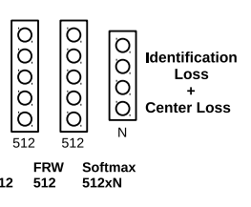
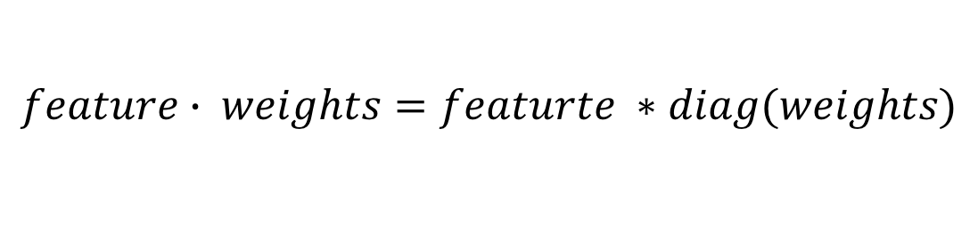
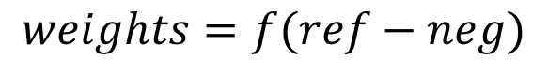
Future work: weights layer
Motivation: emphasize the importance of each embedding dimension
$$feature∙ weights=featurte ∗diag(weights)$$
We think weights is related to (ref – neg)
$$weights=f(ref−neg)$$

Slide 28
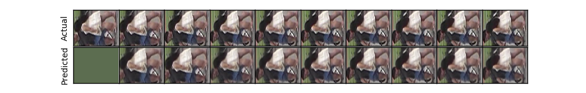
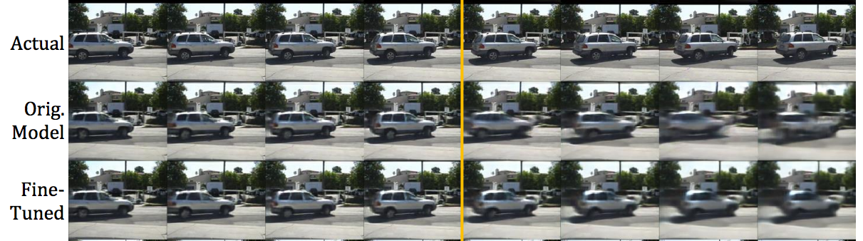
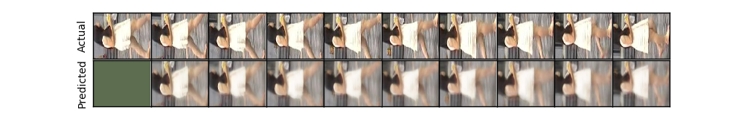
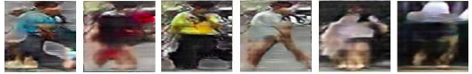
Future work: Prednet
GAN:
More diversity
More uncontrollable& unnatural artificial
Unlabeled

Slide 29
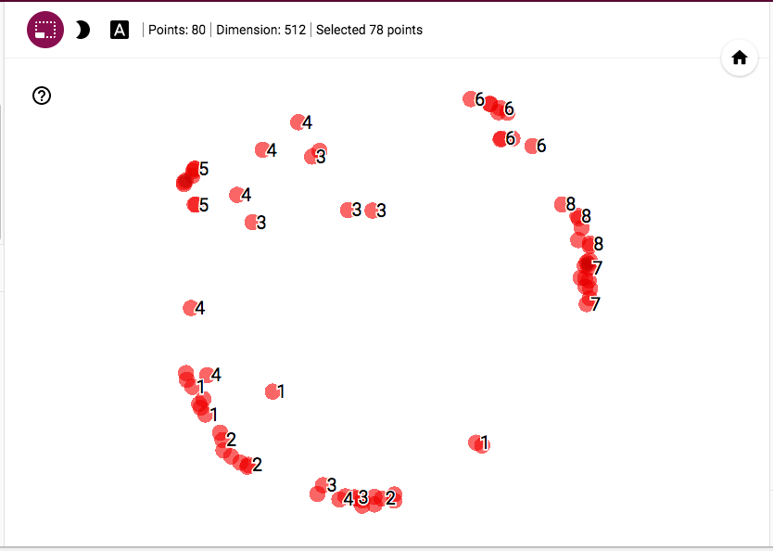
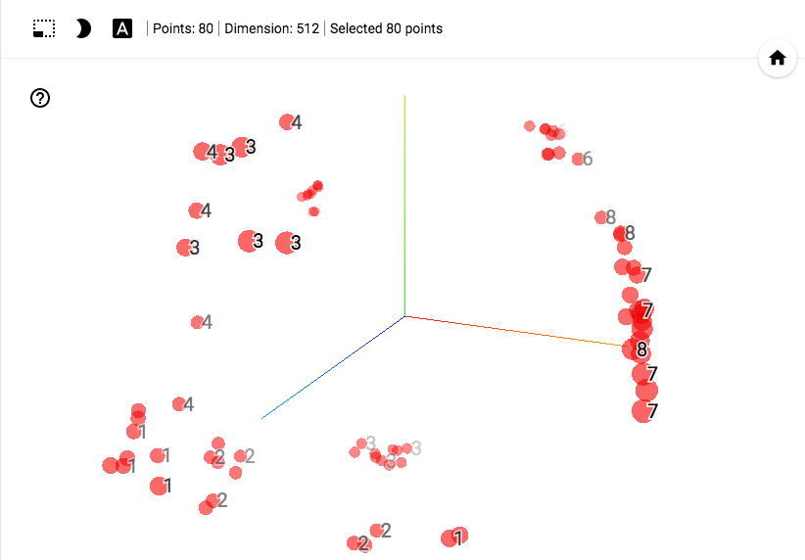
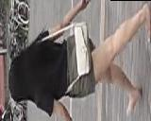
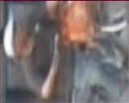
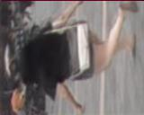
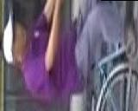
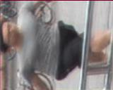
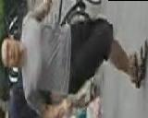




Future work: Prednet
Tensorboard: t-sne
1: Id1 true image
2: Id1 fake image
3: Id2 true image
4: Id2 fake image
5: Id3 true image
6: Id3 fake image
7: Id4 true image
8: Id4 fake image
data argumentation:
GAN or Prednet?

Slide 30
Future work
Test other works
State of the arts
Resolve unsupervised transfer learning problem (datasets bias)
Person search with NLP is becoming popular

Slide 31
THANKS !

